Slide 1
Capstone Engagement
Assessment, Analysis, and Hardening of a Vulnerable System
By Riley Peters

Slide 2
Table of Contents
This document contains the following sections:
01
Engagement Introduction
02
Network Topology
Red Team: Security Assessment
03
04
Blue Team: Log Analysis and Attack Characterization
Hardening: Proposed Alarms and Mitigation Strategies
05

Slide 3
Engagement Introduction
‹#›

Slide 4
Engagement Introduction
Capstone Attack
Welcome to the Capstone Engagement Report. Documented in this report are the findings of both our Red and Blue team, detailing vulnerabilities and exploits currently on the Capstone Apache Server, and their respective prevention methods.
The collection of this data and attack on the server by the Red Team occured on the 18th of July, 2022.
The Red Team were able to successfully penetrate the Capstone server and obtain access to private, sensitive data owned by the company. Proof of access is provided in this report.
While the exploit discovered was severe, it was also largely avoidable. The strategies and mitigation methods needed to prevent this in the future are documented by the Blue Team in this report.

Slide 5
Network Topology
‹#›

Slide 6
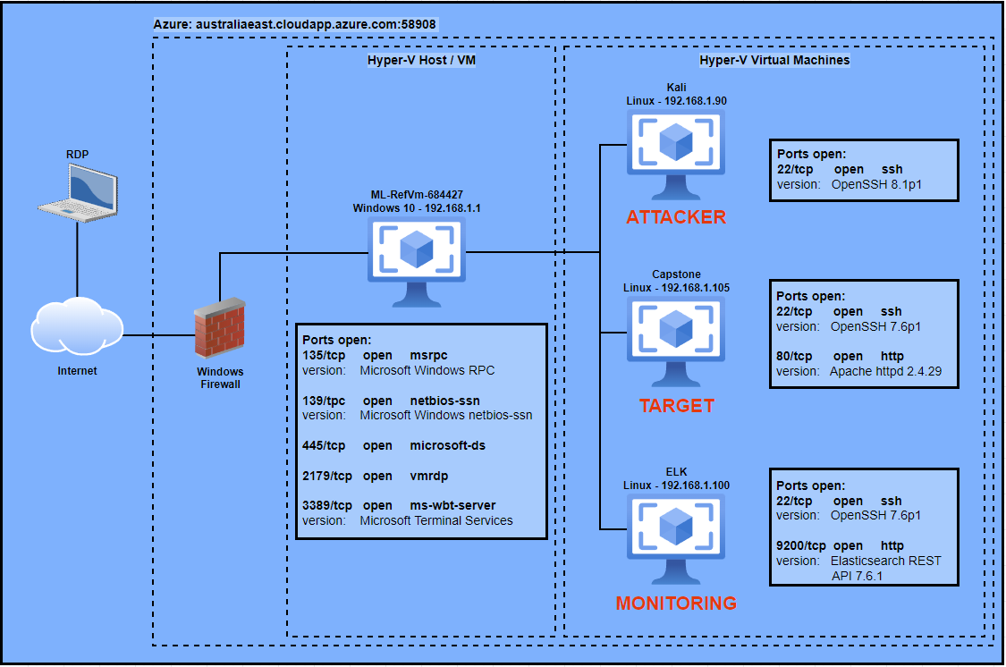
Network Topology
[Insert Here]
Use draw.io to create a diagram of the network.
Add your diagram to this slide and fill out the data in the sidebar.
Network
Address Range: 192.168.1.0/24
Netmask: 255.255.255.0
Gateway: 192.168.1.1
Machines
IPv4: 192.168.1.1
OS: Windows 10
Hostname: ML-RefVm-684427
IPv4: 192.168.1.90
OS: Linux
Hostname: Kali
IPv4: 192.168.1.105
OS: Linux
Hostname: Capstone
IPv4: 192.168.1.100
OS: Linux
Hostname: ELK

Slide 7

Red Team
Security Assessment
‹#›

Slide 8
Recon: Describing the Target
Nmap identified the following hosts on the network:
Hostname | IP Address | Role on Network
ML-RefVm-684427 | 192.168.1.1 | Host/Gateway/Network Address Translation (NAT) Switch
Kali | 192.168.1.90 | Penetration Testing Workstation/Attacking Machine
Capstone | 192.168.1.105 | Web Server/Target Machine
ELK | 192.168.1.100 | SIEM Machine/Stack

Slide 9
Vulnerability Assessment
The assessment uncovered the following critical vulnerabilities in the target:
Vulnerability | Description | Impact
Sensitive Data Exposure | Sensitive data referring to hidden directories and/or files is publicly viewable on the server. | A hidden directory ‘/company_folder/secret_folder/’ was found after it’s path was described multiple times in files located within ‘/meet_our_team/’.
Bad Passwords/No Account Lockout | Combination of brute-forceable (weak) passwords and no account lockout policy enables attackers to break into accounts. | Hydra tool was used to brute-force access into the ‘/secret_folder/’ and instructions on how to access the servers file system via WebDAV were discovered.
Unauthorised File Upload/Persistent Backdoor Access | No authorisation/authentication needed when uploading files to the server - enables multiple exploits to be attempted including backdoor access. | Once connected via WebDAV, a payload was uploaded which when executed, opened a reverse shell backdoor to the server. Payload could be executed multiple times from the public webpage allowing for persistent access to the file system.

Slide 10
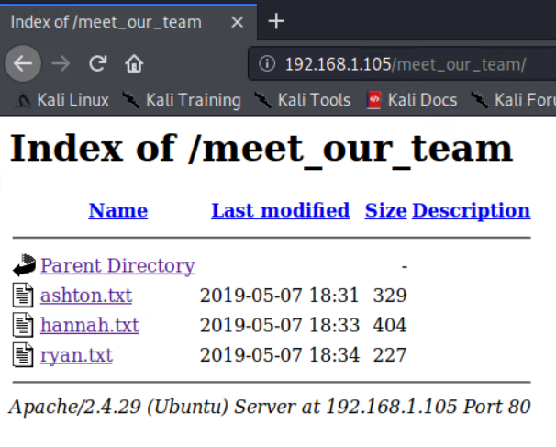
Exploitation: Sensitive Data Exposure
01
02
03
Tools & Processes:
Using a web browser and the server’s IPv4, it was possible to access the ‘public’ facing end of the web server. Here, directories could be looked through for clues about deeper access.
On top of this, it was also possible to locate hidden directories using the dirb tool: dirb 192.168.1.105
Achievements:
Upon finding the file ‘ashton.txt’ in the folder ‘meet_our_team/’, it was clear Ashton was the admin of a hidden folder called ‘secret_folder’. On top of this, it was clear through other team member files that Ashton was not considered to be a very good directory administrator.
The dirb tool also uncovered two hidden directories, with one being ‘/webdav/’
Below are screenshots to provide proof and results. Continued on next slide.
/meet_our_team/ directory shown above.

Slide 11
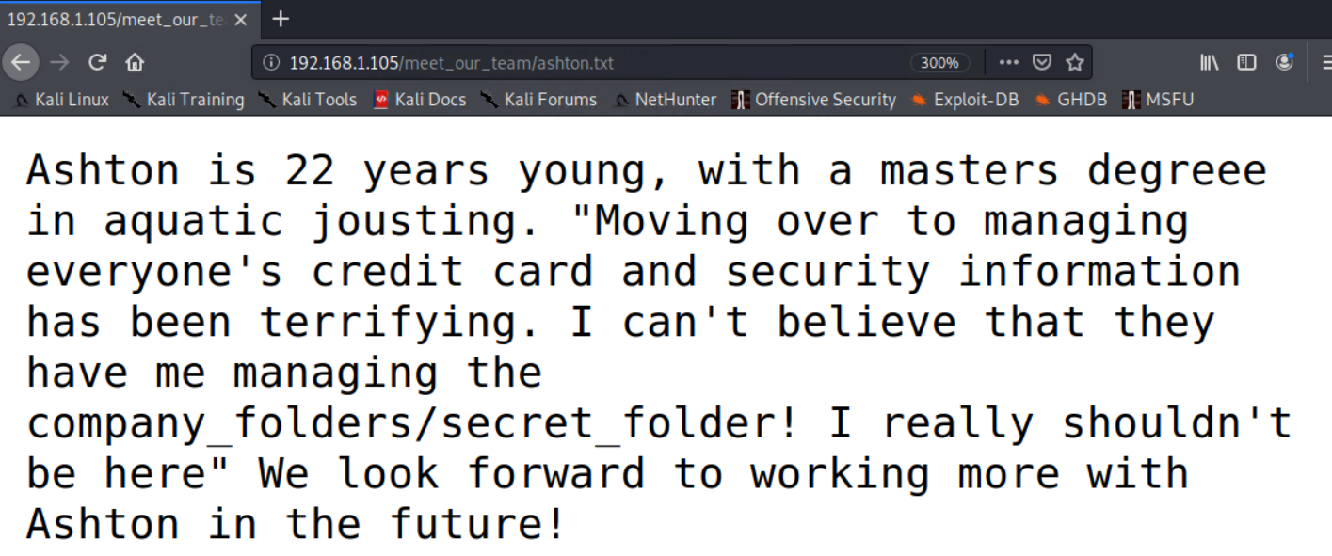
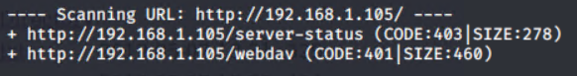
Sensitive Data Exposure: Proof
← Contents of ashton.txt
Results of dirb command. Two domains found →
The domain ‘/server-status’ is an Apache feature to show server administrators system information.
Both domains require authentication but the domain ‘/webdav’ shows that it is possible to remotely upload, create and modify files and folders on the Apache server using that service.

Slide 12
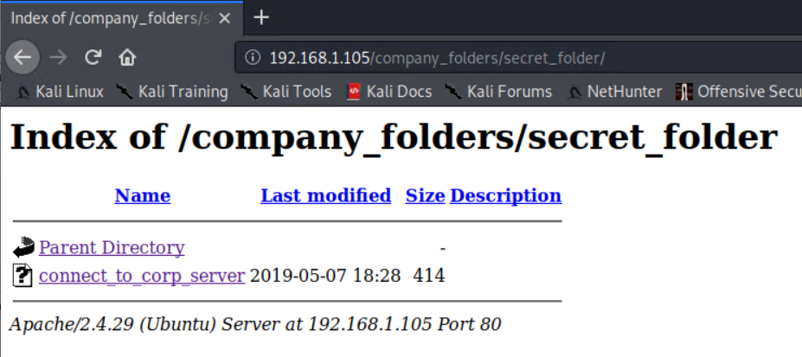
Exploitation: Bad Passwords / No Account Lockout
01
02
03
Tools & Processes:
Once knowledge was obtained on the ‘/secret_folder’, the Hydra tool was used to brute-force access to this page through the user ‘ashton’.
Crackstation.net was also used to crack an MD5 hash of a weak password.
Achievements:
Using the Hydra tool along with the ‘rockyou.txt’ wordlist, ashton’s password was able to be cracked and access was gained to the hidden directory ‘/secret_folder/’. Inside this directory, instructions for accessing the server via WebDAV were found, along with a crackable MD5 hash containing the password for the user account ryan.
Access Obtained:
Inside is a file named ‘connect_to_corp_server’. Contents on next page.

Slide 13
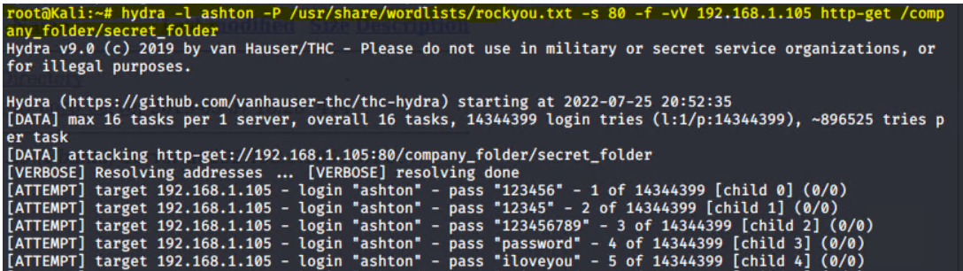
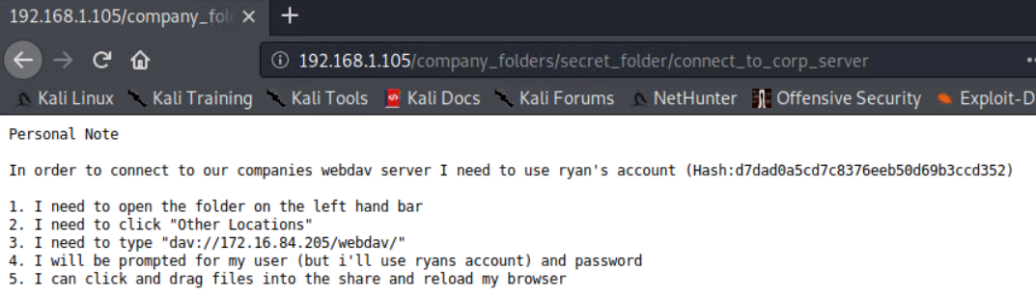
Bad Passwords / No Account Lockout: Proof
← Hydra command used highlighted, password match
found for ryan’s account was ‘leopoldo’.
Contents of ‘connect_to_corp_server’, along with ryan’s password hash and
details on WebDAV server file access.
→
← crackstation.net was used to crack the password
quickly. The resulting password for ryan’s WebDAV
account was ‘linux4u’.

Slide 14
Exploitation: Unauthorised File Upload / Persistent Backdoor
01
02
03
Tools & Processes:
With access to the server’s file system, it was possible to upload a malicious payload containing a reverse shell script. This was constructed using the msfvenom tool. The msfvenom module used was: php/meterpreter/reverse_tcp
which creates a reverse shell with a listening machine.
Achievements:
After a listener was configured on the attacker machine, it was possible to use a file explorer to connect to the ‘/webdav/’ directory and sign in using ryan’s account. From here, the msfvenom payload could be uploaded to the server as a .php file and activated on the respective webpage:
http://192.168.1.105/webdav/
Activating the uploaded payload allowed the attacker listener to receive a reverse meterpreter shell on the server. From here, the ‘/’ folder above /webdav/ could be accessed and after listing its contents, the file flag.txt was located. Using the cat command displayed the flag within.
Flag: b1ng0w@5h1sn@m0

Slide 15
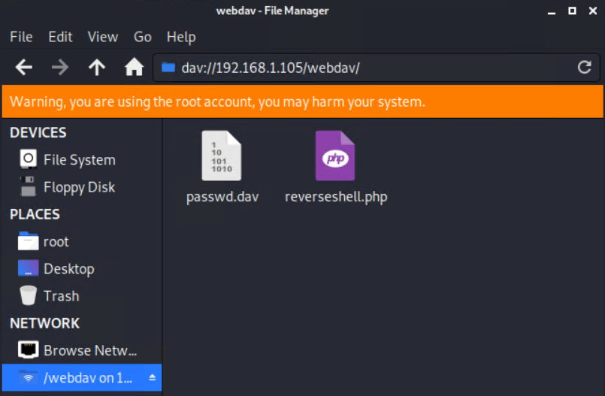
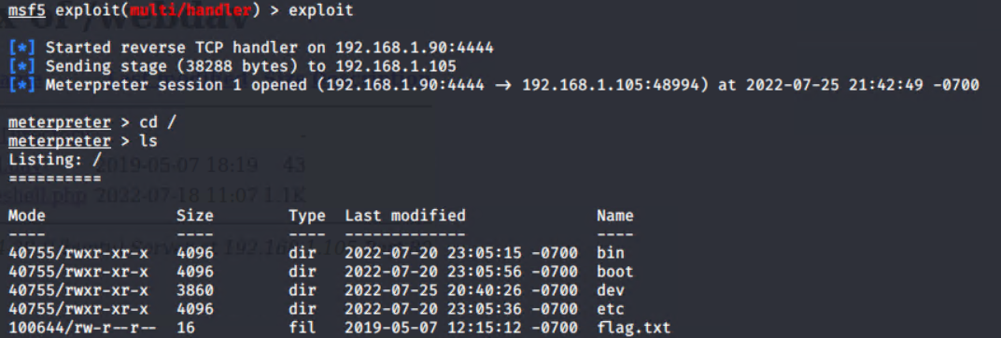
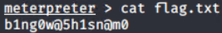
Unauthorised File Upload / Persistent Backdoor: Proof
← Accessed gained to /webdav/ through file explorer and uploaded malicious
.php payload.
Meterpreter session opened followed by moving back a directory and listing the contents. At the bottom appears
flag.txt.
→
← Proof of flag.txt contents.

Slide 16

Blue Team
Log Analysis and Attack Characterization
‹#›

Slide 17

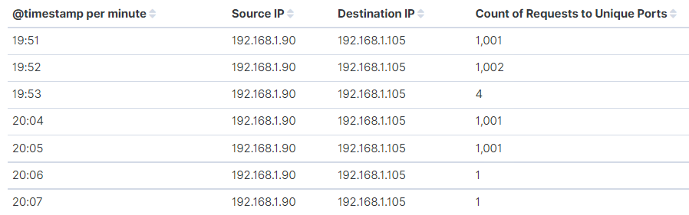
Analysis: Identifying the Port Scan
According to the log data, there were multiple port scans initiated against the Capstone server first at 7:51pm and then the last one at 8:05pm, on the 18th of July 2022.
Over 1000 network packets were sent from the attacker IP in each scan attempt.
Receiving large amounts of network packets to such a high number of unique ports is very telling of a port scan.
[Insert Here]
Include a screenshot of Kibana logs depicting the port scan.

Slide 18
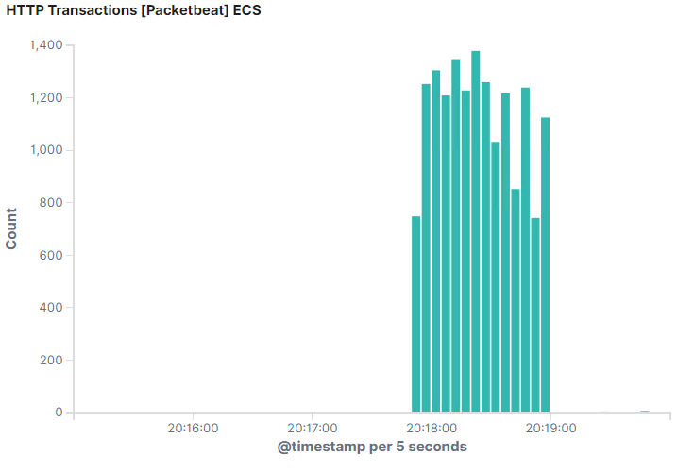
Analysis: Finding the Request for the Hidden Directory
According to the log data, the initial requests to access the ‘/secret_folder/’ began at 8:17:50pm, on the date in question. Over the following two minutes, almost 16,000 requests were made to this hidden directory.
Once access had been obtained by the attacker, the file ‘connect_to_corp_server’ was requested from inside the directory. This file contains sensitive company information with instructions to access the server file system via WebDAV. Proof extends to next slide.
← Graph showing the count of HTTP transactions to the server from
the attacking machine over time. Here, it is possible to see the initial
start of the large amount of requests, as well as how many were
made during this period (in intervals of 10 seconds).

Slide 19
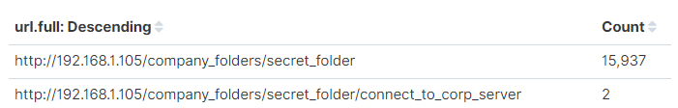
Analysis: Finding the Request for the Hidden Directory
← The URL being requested and the count of
requests to that URL. The second entry is the
file located within the hidden directory.
Contents of said file within the ‘secret_folder’ directory
- connect_to_corp_server
→

Slide 20
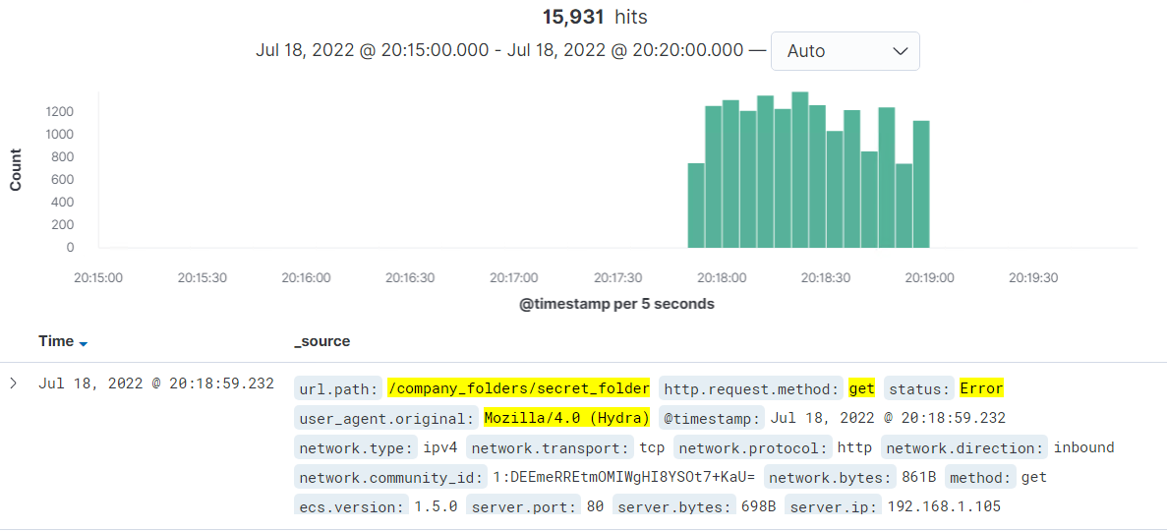
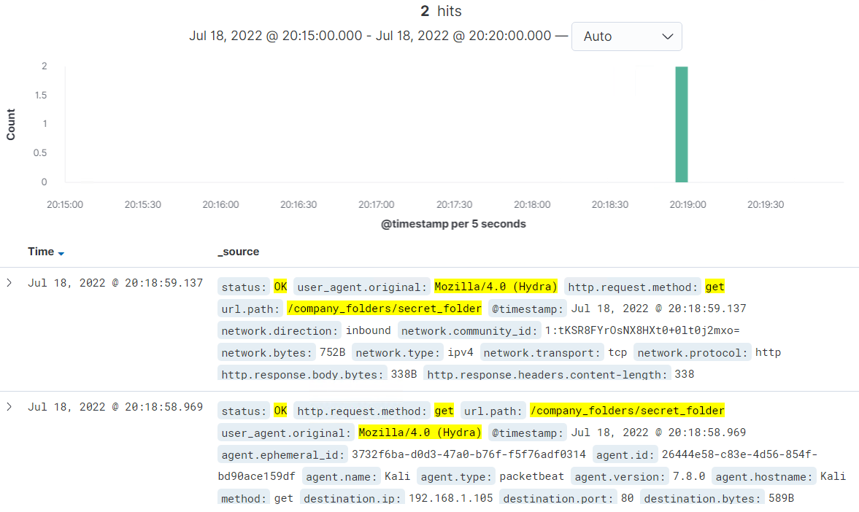
Analysis: Uncovering the Brute Force Attack
During the attack as mentioned previously, 15,933 requests were made to the hidden directory from the user agent ‘Mozilla/4.0 (Hydra)’ - a known brute-force tool.
Of these, 15,931 were Errors, indicating failed attempts to crack the password.
The remaining 2 requests were met with a status of OK, indicating the password had been cracked and then verified. This occurred at 8:18:55pm, on the date in question.
The above table shows the total request count from the Hydra user agent. The graphs below show the Error count from that user agent as well as the OK requests indicating the password had been cracked.

Slide 21
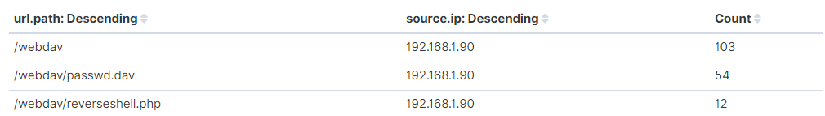
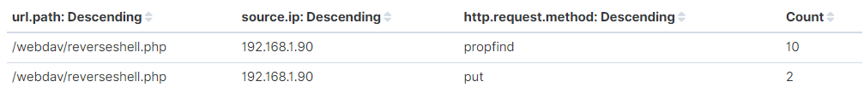
Analysis: Finding the WebDAV Connection
In total, 169 requests were made to the ‘/webdav/’ folder and its contents. The count of each detailed below.
The passwd.dav file containing sensitive password data was requested and accessed multiple times, as well as the upload and execution of ‘reverseshell.php’ payload at 9:07:02pm.
Of the 12 requests for this particular resource, two were related to the upload of the file (http method PUT), while the other ten were related to the execution of the payload (http method PROPFIND).
← Count of requests for each resource
Shown above, the HTTP request method count pertaining to ‘/webdav/reverseshell.php’
On the next slide is a more detailed look into these requests.

Slide 22
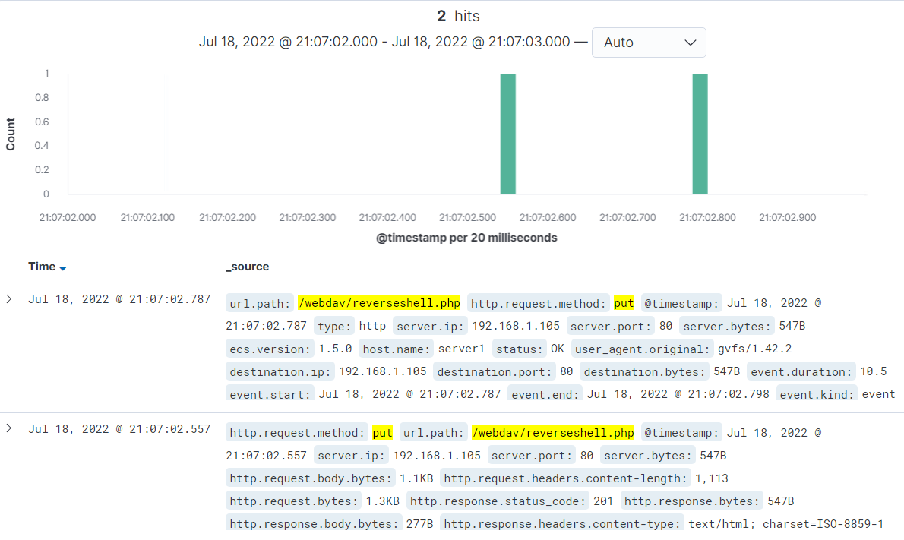
Analysis: Finding the WebDAV Connection
Detailed overview of the two HTTP PUT requests issued to the server through WebDAV. This reverse shell file was now accessible on the ‘/webdav/’ domain. Note that in the second entry, the http.response.status_code is a 201, indicating a request has succeeded and in turn, a resource has been created successfully on the server.
Likely reason for two entries instead of one is a double click on the attackers behalf, as they are roughly 20 milliseconds apart.

Slide 23
Blue Team
Proposed Alarms and Mitigation Strategies
‹#›

Slide 24
Mitigation: Blocking the Port Scan
In the interest of mitigating this kind of attack in the future, an alarm/alert can be used to detect or prevent port scans early.
In this instance, an alert that triggers when a certain number of ports (that aren’t port 80) have been pinged/scanned by the same source IP would help in preventing and blocking further malicious traffic. To view this data in Kibana, the following search is required:
destination.ip: 192.168.1.105 and NOT destination.port: 80 and source.ip: *
A suitable threshold trigger for an email alert would be 5 or more attempts to access ports that aren’t 80 from the same source IP over a one minute interval.
When it comes to actual system and configuration hardening, there are a few methods to help block port scans. A simple one to help prevent this traffic in the first place would be to block all ping responses for all ports.
A more rigid solution would be the use of a firewall along with rules on incoming and outgoing traffic. Configuring a rule to block all traffic, incoming and outgoing, that isn’t going to or leaving port 80, is realistic as this is the only port that must be open for the server to be functional. The firewall can then handle the filtering of traffic through port 80. This in conjunction with alerting will help prevent port scans.

Slide 25
Mitigation: Finding the Request for the Hidden Directory
When it comes to unauthorised requests for access to the hidden directory, the following search and corresponding alert will be capable of detecting such traffic once configured.
url.path: /company_folder/secret_folder and NOT source.ip: 192.168.1.105
This search will show the number of requests to the hidden directory from IPs other than the Capstone server itself. A suitable alert trigger would be any number (one or more) of attempts to access the hidden directory. This trigger would send an email alert to the system administrator and notify them of unknown requests.
Whilst the firewall in the previous slide would help with blocking traffic, it would also be smart to harden the Capstone host itself. To do this, we can use the Apache host file to state which IP’s we want to allow access to the hidden directory.
In this case, the Apache host or config file for this version is called ‘httpd.conf’. A detailed explanation on how to edit this file is available on the Apache website, and shows how to allow or deny access from certain IPs by stating these IPs in this configuration file.
https://httpd.apache.org/docs/2.4/howto/access.html

Slide 26
Mitigation: Preventing Brute Force Attacks
In the interest of preventing brute force attempts in the future, this search and alert will help detect these attacks and send an email/text to an administrator.
user_agent.original: “Mozilla/4.0 (Hydra)” and url.path: /company_folder/secret_folder
This search will show the number of requests to the specified path from the Hydra user agent over a time period. An email alert should then be set to trigger anytime this number of requests surpasses 10 over any amount of time, notifying the administrator of the attack.
When it comes to hardening account security, there are many tools available to help secure accounts. In this case, a rigid password policy would ensure employees, such as ashton, cannot use weak or ‘bad’ passwords, and guarantee their passwords must be complex and changed at regular intervals.
On top of this, an Account Lockout policy would also greatly benefit the server, as it would ensure that after a set amount of failed logins to an account, that account would be locked out of the system for a set period of time and unable to perform any actions. This is an extremely common method of blocking brute force attacks.

Slide 27
Mitigation: Detecting the WebDAV Connection
Concerning the WebDAV connection, the following search and alert will detect unwanted connections to the ‘/webdav/’ directory, much the same as the hidden directory.
url.path: /webdav/ and NOT source.ip: 192.168.1.105
Trusted IPs can be added to the source.ip list in the search if it is unnecessary to detect traffic from them. This is the same for the hidden directory search. An email alert will trigger when any unwanted traffic attempts to access the ‘/webdav/’ directory.
Being a similar access control issue to a directory like ‘/company_folder/secret_folder’, the same methods used in that hidden directory can be applied here.
By editing your Apache config file (found in /etc/httpd/conf/httpd.conf) and adding allow or deny rules for certain IPs under desired directories, the server will block traffic from unwanted or untrusted sources to that resource or folder.
For further details:
https://httpd.apache.org/docs/2.4/howto/access.html

Slide 28
Mitigation: Identifying Reverse Shell Uploads
For detecting unauthorised file uploads to the ‘/webdav/’ directory, the following search and alert can be employed.
url.path: /webdav* and http.request.method: put and NOT source.ip: 192.168.1.105
This search will show all HTTP PUT requests made to the server from unwanted or untrusted IPs. Adding IPs to the source.ip will allow them to upload without being detected in the search. An email alert should trigger when any form of PUT request is detected at any point in time, as only authorised IPs should be allowed to upload at all.
If the steps outlined in the section regarding mitigation against unwanted access to hidden directories have been implemented, then that is already a rigid control to mitigate against this scenario as well.
Further steps would be to employ the use of anti-virus software, to help scan and detect malicious files potentially being uploaded from a trusted IP. Depending on product and configuration, AV can detect known exploit signatures and block associated traffic as it attempts to reach the server.

